Slide 1

Credit Card Fraud Detection
EAS 345

Slide 2
Addressing the Project Sponsor

Slide 3
Motivation and Business Need
Business Need: Financial organizations need to reduce financial losses while minimizing disruption to legitimate customers
Key Pain Point: Fraud detection systems were producing a high false positive rate, resulting in unnecessary manual reviews and customer friction
Motivation: Improve the accuracy of fraud detection so that fewer legitimate transactions are flagged while still catching fraudulent activity earlier
Project Sponsor: Dr. Sabato, Intro to Data Science professor, overseeing the initiative

Slide 4
Project Goal
The overall goal of the project was to build a machine learning model that accurately predicts fraud to reduce false positives and financial loss
Target Improvements:
Recall > 85% (catch more actual fraud)
Precision > 90% (minimize false positives and reduce manual review load)
These accuracy goals directly support the sponsor’s priority: Fewer false alarms leads to fewer interruptions to legitimate customers, leading to lower operational costs

Slide 5
Key Results
Model Used: XGBoost, selected for its strong performance on structured fraud data
Performance Summary
Zero False Positives: No legitimate customers were incorrectly flagged
Model caught 99.97% of all fraud cases
The model dramatically reduces customer friction while greatly improving fraud detection accuracy

Slide 6
Project Workflow Overview
Preprocessing Stage
Data cleaning
Missing value imputation
Feature engineering
Feature selection
Model Development
Trained XGBoost model on engineered features
Tuned using validation set
Final evaluation on an unseen test set
Dataset Size
Train Set: 413,378 rows x 331 features
Validation Set: 88,581 rows x 331 features
Test Set: 88,581 rows x 331 features
Tools Used
R, Rstudio, XGBoost Package, GitHub, and RDS conversion to store large datasets efficiently

Slide 7
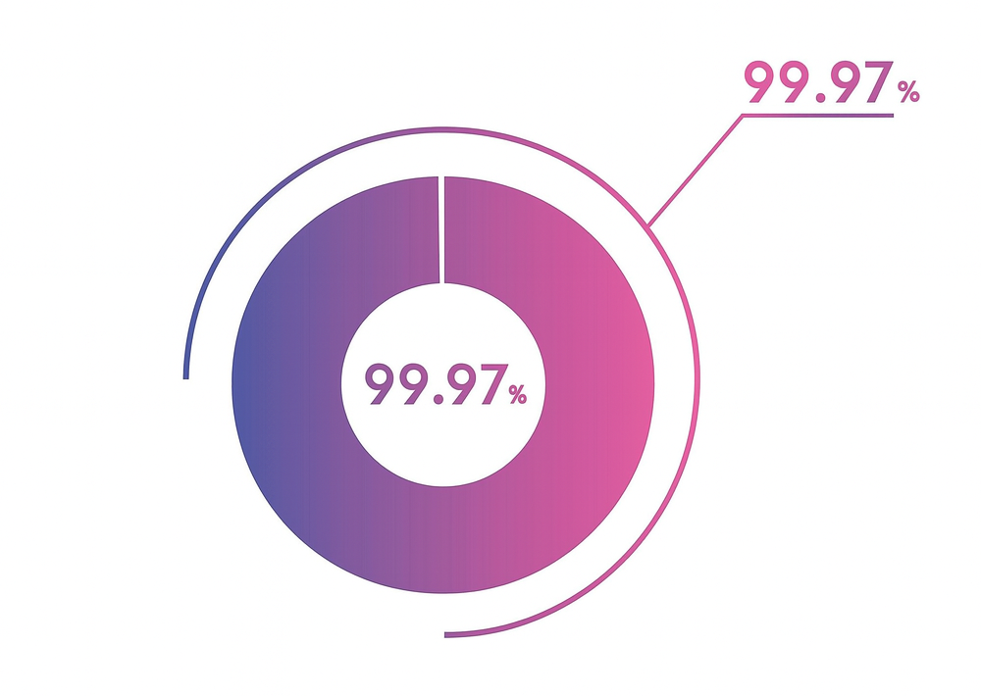
Business Impact
Zero False Positives lead to a better customer experience
Legitimate customers are no longer interrupted
Smoother transactions and fewer complaints
99.97% Fraud detection means strong protection
- Major reduction in financial losses
- Earlier and more reliable fraud prevention
This project provides immediate benefit
Manual review workload drops significantly, freeing staff to focus on the most critical cases

Slide 8

Model Effectiveness
The model caught 99.7% of all fraud cases, demonstrating highly reliable detection
Legitimate transactions are not incorrectly flagged, ensuring smooth customer experience
The model performs better than previous processes in accuracy and consistency, reducing manual review workload
The model works reliably in real-world scenarios, protecting the business while minimizing customer disruption

Slide 9
Modeling Method Overview
XGBoost was the chosen model because prior research and literature show that XGBoost performs well on fraud detection tasks
The model uses patterns in historical data to make highly accurate predictions on new transactions

Slide 10
Recommendation and Future Work
Recommendation: Deploy the model in the fraud detection workflow to immediately reduce manual reviews and financial losses.
Outstanding Issue: Model Interpretability. Understanding why the model makes a prediction is still challenging and should be improved for transparency and trust
In the future, expanded feature selection tasks should be done to identify the most informative variables and potentially improve performance even further

Slide 11
Addressing the End User

Slide 12
Why This Model Matters to You
End Users: Bank employees responsible for fraud review and customer transaction monitoring.
Too many false positives leads to constant review of transactions that turn out to be legitimate
From the end user’s perspective, the project goal was to build a model that reduces false positives and prioritizes the transactions that truly need your attention
Our model has less noise, more accuracy, and provides more time to focus on genuine fraud cases

Slide 13

Model in Day-to-Day Work
Prior to the Model
Rule based system
Many alerts triggered by simple heuristics
Heavy manual review
Most flagged transactions turned out to be legitimate
After the Model
Only high-risk transactions are flagged
Far fewer alerts to sift through
Alerts are backed by a powerful predictive model
More accurate alerts lead to faster decisions, less wasted time, and more focus on real fraud

Slide 14
What the Model Catches – And What It Ignores
Fraud Pattern the Model Flags:
- Overseas transactions that are unusual for the customer
- Helps end users quickly spot high-risk activity that often indicates compromised cards
Legitimate Pattern the Model Avoids Flagging
- Small local purchases, which are typically part of normal customer behavior
- Reduces unnecessary alerts and customer inconvenience
Input End Users Care About Most
Location. This aligns with the factors employees already use when manually evaluating transactions.

Slide 15
How You Interact With the Model
You use the model through an alert system that notifies you only when a transaction is considered high risk.
The model provides a clear fraud / not fraud label for each evaluated transaction.
The script would output a list of flagged transactions, including relevant details such as amount, time, and location.

Slide 16
Your Role in Improving the Model
We ask that you report unusual fraud patterns that you detect manually that the model may not yet recognize
Simply send an email whenever you notice a suspicious pattern or a case the model misclassified.
Your insights help the model learn emerging fraud behaviors.
Continuous improvement strengthens fraud prevention and reduces your workload over time.

Slide 17
Addressing Other Data Scientists

Slide 18

Problem Overview
Problem Type: Binary classification of fraudulent transactions using tabular data (IEEE-CIS Fraud Detection Dataset).
Technical Challenges
Extreme class imbalance – very few fraud cases compared to legitimate transactions
Noisy features – some features contain irrelevant or inconsistent information
High dimensionality – 331 features, increasing risk of overfitting and complicating feature selection
Objective: Develop a robust model that accurately identifies fraud while handling these challenges.

Slide 19
Previous Approaches in Fraud Detection
Common Approaches in Literature
Rule based systems – simple heuristics for flagging suspicious transactions
Machine learning models
LighGBM
Random Forest
XGBoost
How Our Approach Differs
Implemented a superior preprocessing pipeline
More effective handling of missing values
Feature engineering and selection tailored for this dataset
Takeaway
While the model choice (XGBoost) aligns with prior work, our data preparation and feature handling provide a competitive advantage.

Slide 20

Data Preprocessing Approach
Step 1
Data Integration
Left join train_transaction and train_identity on transactionID
Drop columns with greater than 95% missing values
Step 2
Outlier and Zero Transaction Handling
Remove transactions with TransactionAmt == 0
Flag top 1% of transaction amounts
Step 3
Missing Value Treatment
Numerical Features
Categorical Features

Slide 21
Data Preprocessing Approach (continued)
Step 4: Encoding
Data Integration
Left join train_transaction and train_identity on transactionID
Drop columns with greater than 95% missing values
Step 5: Feature Engineering
Temporal Features
From transactionDT, extract hour, day_of_week, day_of_month, week_of_year. Compute transaction velocity per user: transactions per hour and transactions per day.
User Level Aggregates
For each card1 calculate mean_amt, std_amt, tx_count_7d, amt_std_30d, unique_devices_30d
Transformations
Apply log(TransactionAmt + 1) to reduce skewness

Slide 22
Data Preprocessing Approach (continued)
Step 6: Feature Selection
Drop one variable in any pair with Pearson correlation > 0.9
Step 7: Handling Class Imbalance
Class imbalance was handled directly in XGBoost using scale_pos_weight
Step 8: Output and Documentation
Export cleaned dataset

Slide 23
Model Choice and Key Dataset Challenges
Model Choice: XGBoost
We chose XGBoost because it handles structured data efficiently and handles class imbalance effectively
Key Dataset Challenges
Extreme class imbalance
Fraud cases less than 3.5% of total transactions
High dimensionality
Hundreds of features
Noisy/Randomized variables
Many features with unclear semantics

Slide 24

Results and Findings
Model Performance
Recall: 0.9997
Precision: 1.0000
AUC: 1.0000
Interpretation: The model produced zero false positives and caught 99.97% of all fraud cases
Feature Insights
The most influential features from the XGBoost importance matrix were dist1, R_emaildomain, and dist2_missing
Technical Observations
Model performance far exceeded the original target (Recall > 85%, Precision > 90%).
Feature selection and preprocessing pipeline likely contributed to the perfect AUC

Slide 25

Future Work
Model Improvements
Expand feature selection to reduce noise and improve interpretability
Test alternative models (e.g., LightGBM) for benchmarking
Data Enhancements
Incorporate additional behavioral or temporal features
Gather more labeled fraud cases to reduce imbalance
Improve feature documentation to reduce ambiguity in randomized fields
Deployment Considerations
Set up a feedback loop with bank employees to capture new fraud patterns
Evaluate model performance in a live environment before full rollout

Slide 26
Conclusion
Key Takeaways
Built a high-performing fraud detection model with near-perfect accuracy
Achieved zero false positives and 99.97% fraud detection
Significantly reduces alert volume and improves operational efficiency
Final Note
Our model demonstrates that with the right preprocessing pipeline and algorithm choice, accurate, low-friction fraud detection is achievable and ready for deployment.

